Slide 1
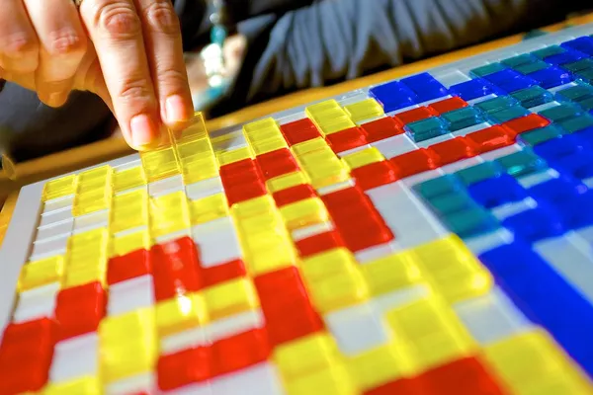
Board Game Club
Beginning a
"A board game impersonating a video game" by Jamie McCaffrey is licensed under CC BY-NC 2.0.
Brian Welch - NDE, 21st CCLC

Slide 2
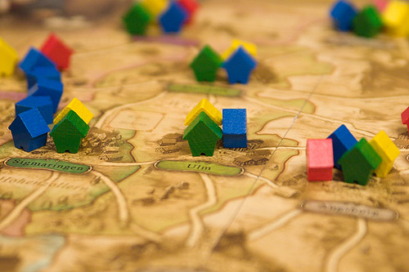
Terminology
Tabletop Game - a game that can be played on a flat surface such as a table
Card Game - a game that uses deck(s) of cards without a board
Board Game - a game that has a playing board in addition to any other components
In this session, the term “board game” will be used to discuss all of these types of games.
"'Thurn and Taxis' (a board game)" by viZZZual.com is licensed under CC BY 2.0.

Slide 3
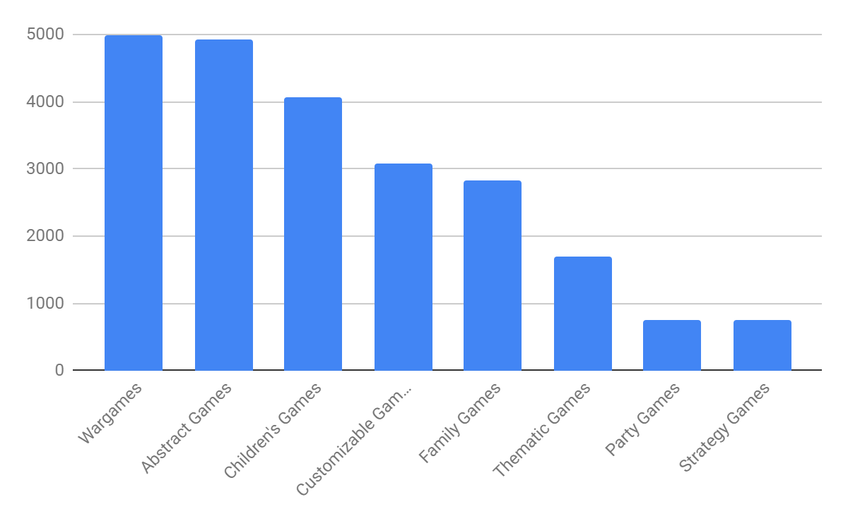
Why Board Games?
Board Game Geek Data - Sep 2022
Total # of Game Entries: 138,900
# of Games by popular game type

Slide 4
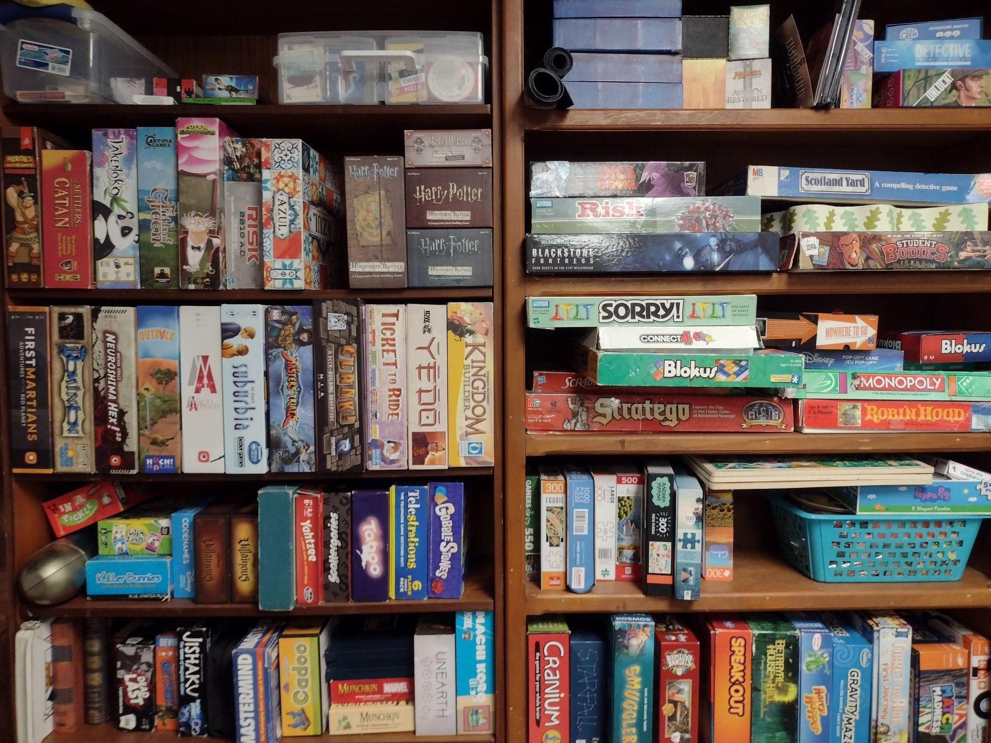
With so many options,
How do you choose?
1. Determine Ability & Effort Level
2. Play Some Games

Slide 5
1. Determine Ability & Effort Level
High School
Middle School
complex reading,
complex rules
Late Elem
moderate reading,
somewhat complex rules
Early Elem
some reading,
basic rules
little to no reading,
basic rules
The “Dave Welch” 2-min Rule
Notes:
“The ‘Dave Welch’ 2-min Rule” is that is any game takes longer than 2 minutes to explain, then it’s not worth the effort needed to play. Dave Welch is my father, and a very intelligent man. However, because he deals with complicated legal documents for his job, he doesn’t want to deal with complicated game rules in his leisure time. He is capable of understanding and playing complicated games, but for him that does not sound like fun. This has led to me finding many games that are very simple to learn, but still have interesting and complex interactions in the game itself. This same principle applies well for games with younger children.

Slide 6
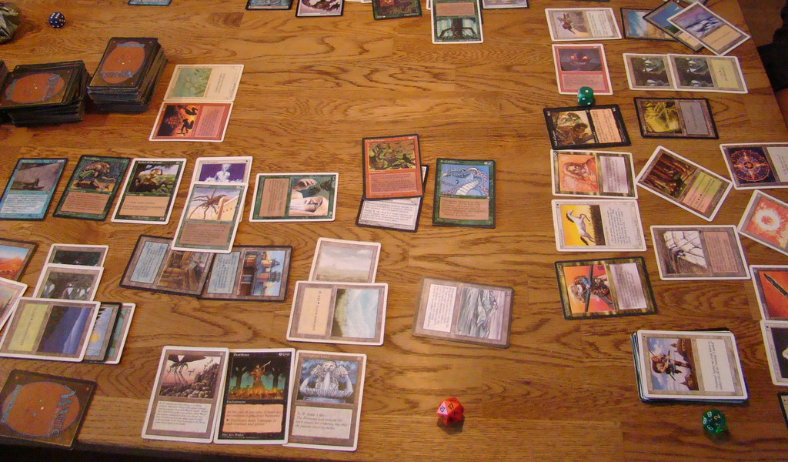
What we’re not talking about
Hobby Games - games that require a significant amount of time or money. Games like this would be better as a stand-alone club.
Role-playing Games
(ex. Dungeons & Dragons)
Miniature Wargames
(ex. Warhammer 40k)
Trading Card Games
(ex. Magic: the Gathering or Pokémon)
"Magic the Gathering" by Shaz Pur is licensed under CC BY-SA 2.0.

Slide 7
Handouts
Running a Board Game Club: Tips
Board Game Library: Starter Suggestions
Expanding Your Board Game Library
Quick-Play Guides: Simplified Board Game Rules
"serious-scaffolding" by dandeluca is licensed under CC BY 2.0.
"Moseley Road Baths (Public Library and Baths, Balsall Heath) - scaffolding - Balsall Heath Public Baths" by ell brown is licensed under CC BY 2.0.

Slide 8
2. Play Some Games
Directions:
Each table has a board game and a “Quick-Play Guide”
Choose a game to play
Try out multiple games or stick with one
Expectations:
Be kind and helpful
Meet new people
Ask if you need help

Slide 9
Debrief
What games did you like/dislike?
What games confused you?
Which games would work well for your students?
How would you go about introducing these games to your students?
What problems might you experience when teaching games to your students?
Other thoughts or questions?

Slide 10
THANKS!
Please keep this slide for attribution

Slide 11
Brian Welch
Afterschool, Family, and Community Engagement Specialist
Email: brian.welch@nebraska.gov
Facebook: @21stCCLCnebraska
Twitter: @NDE_21stCCLC

