Slide 1
Self-Paced
Learning in
4-H
Afterschool

Slide 2
Welcome to Self-Paced
Learning in 4-H Afterschool
Ann Dobesh - UNL Extension Educator
Lori Hamling - UNL Extension 4-H Afterschool Coordinator

Slide 3
You are invited to pick up and check out the tools at your table
Spend a minute or two guessing what they might be used for

Slide 4
Our Goal Today...
Explore the idea of how self-paced learning experiences can be utilized as a delivery strategy in an afterschool setting.
4-H Afterschool in Seward County
How we encourage this program!
Discover Sewing
Self-Paced Learning Experiences
Get YOU involved
What makes it work!
Sample sewing and tools!

Slide 5
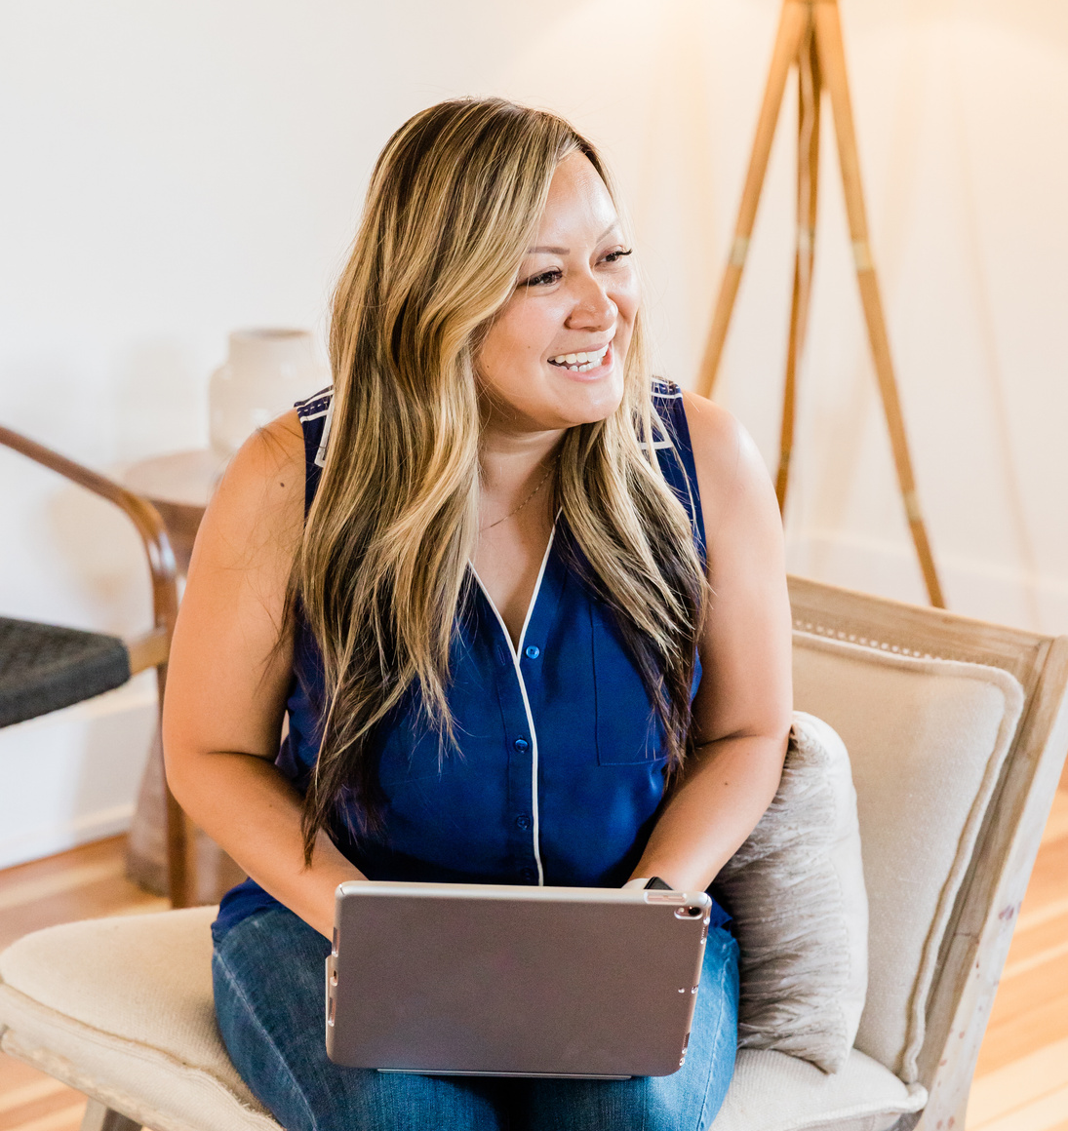
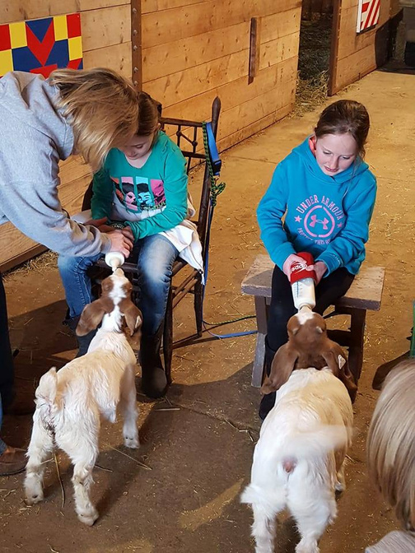
4-H Afterschool
12

Slide 6
4-H Afterschool in Seward County
Exploring Sparks - Opportunities to discover interests and build skills
Safe and Belonging Environment
Youth/Adult Relationships - Opportunities for volunteers to share a skill with young people

Slide 7
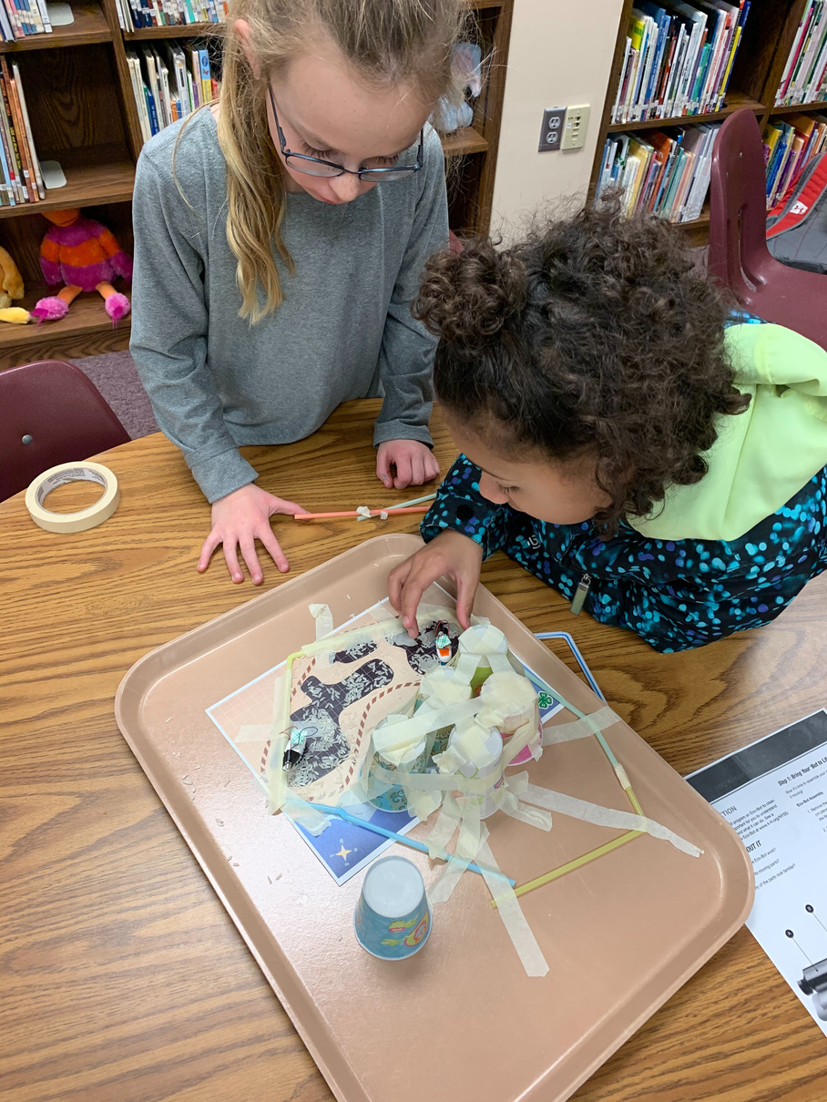
4-H Afterschool Clubs
Last 4 - 12 weeks
Usually meet once per week
Locations vary - staff bring "program" to a site
Focused around a curriculum or topic.
Youth pre-register for the club in advance.
Small fees ($10-$20) per club.
Scholarships available.
Most clubs have a "lesson plan" for the week.

Slide 8
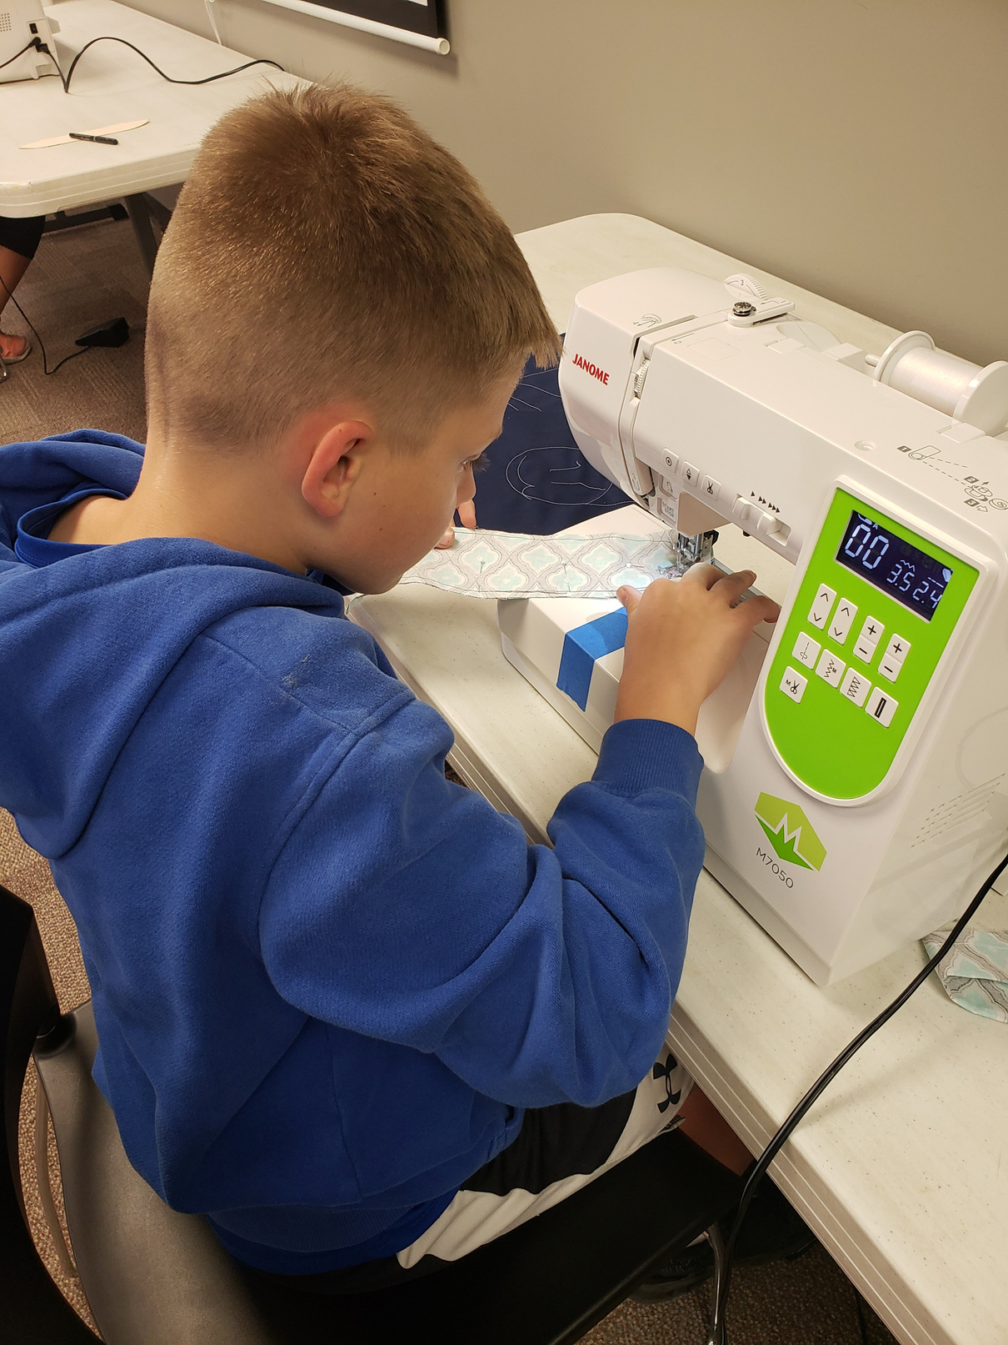
Discover Sewing

Slide 9
How did it begin?
Started at Middle School with one "project" at a time
ie - Pillowcases
Six students
Shorter length (4-5 sessions)
Evolved into several projects and longer period of time
Based on student requests for more
Moved to office meeting room

Slide 10
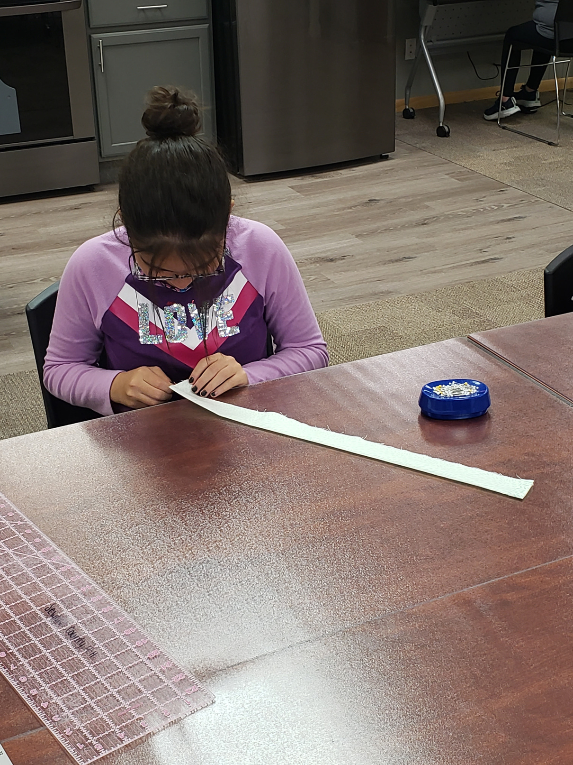
Frequency & Number of Sessions
Once a week
12 weeks

Slide 11
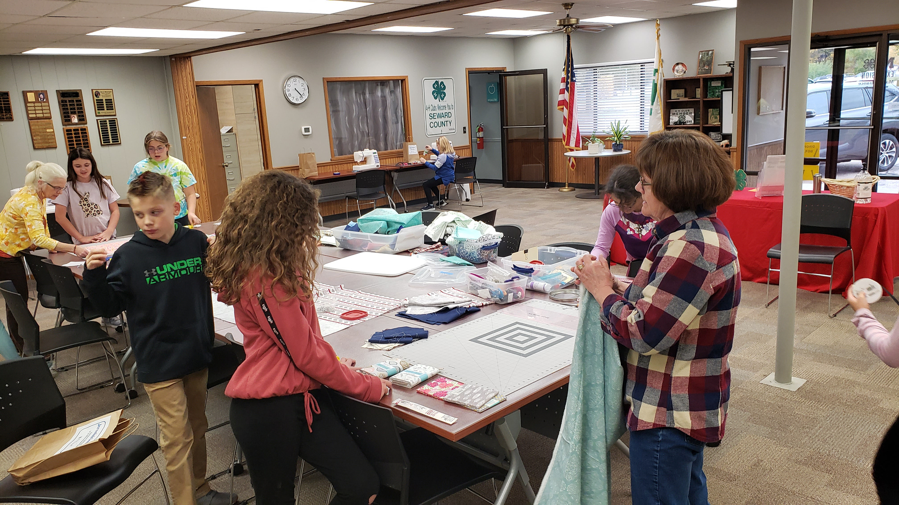
Location & Atmosphere

Slide 12
Location
Suited for groups up to 15
Accessibility of supplies and equipment
Options for transport - public transit
Flexible
Caring, supportive, and relaxed environment

Slide 13
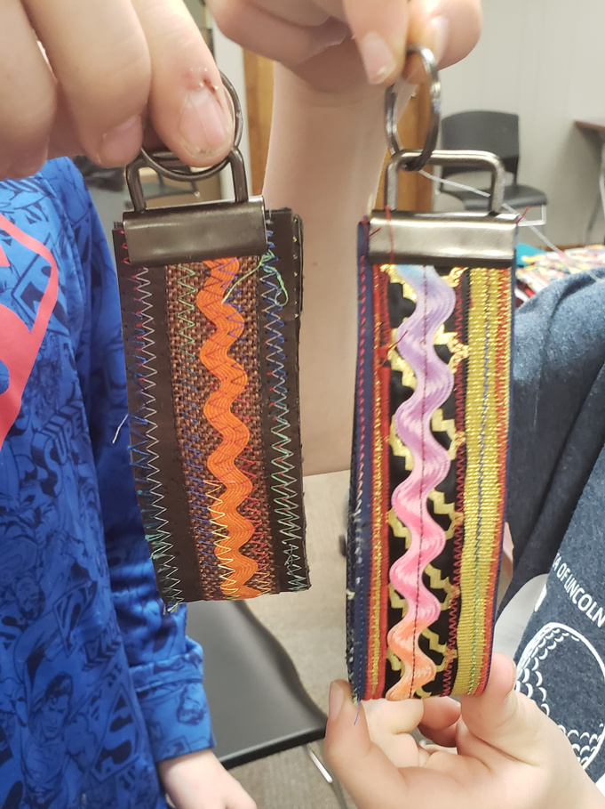
Format
Eight projects offered
pillowcase, scrunchie, apron, floor pillow, key fab
On arrival - snack, attendance, talk about previous week*
Students start as a group
Work at their own pace on each project
Progress from one project to the next

Slide 14
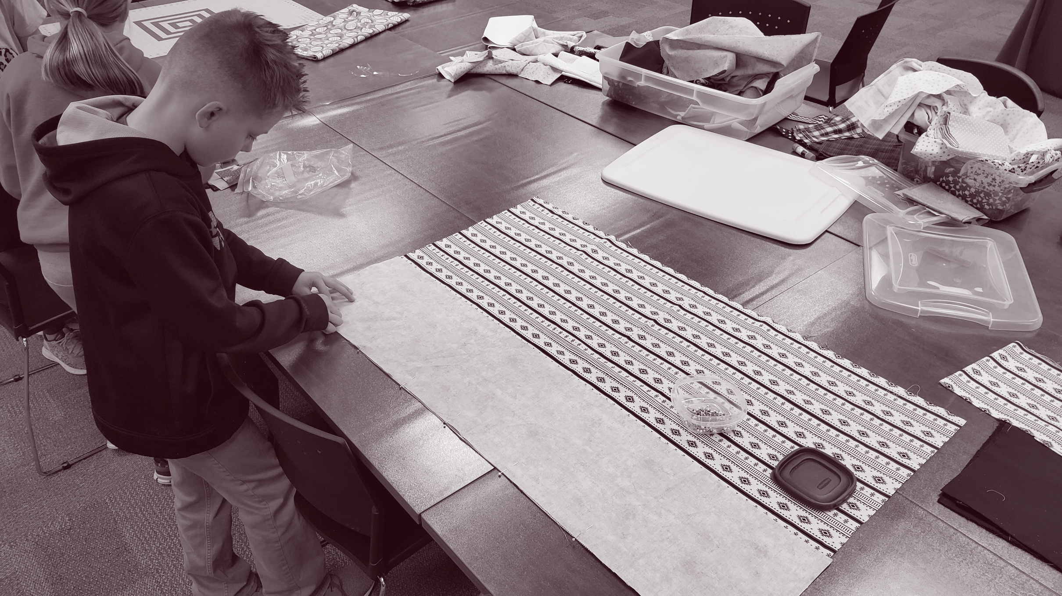
Exploring Sparks through Self-Paced Learning

Slide 15
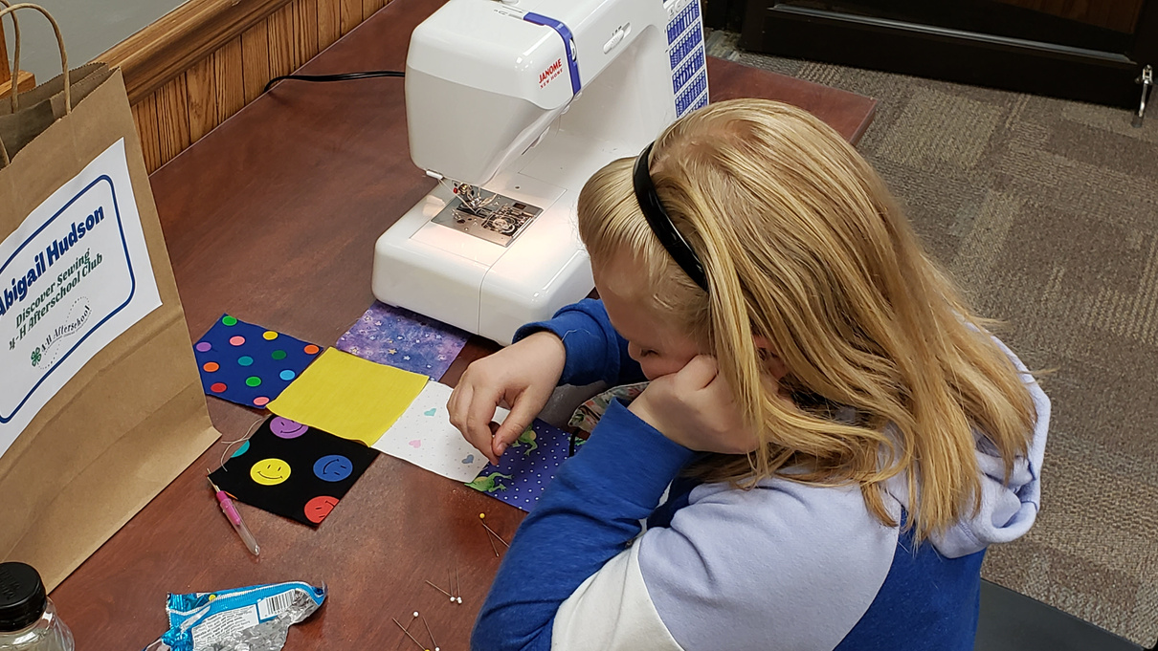
What is Self Paced?
Where youth complete tasks at a speed that is customized to their level of development and mastery.

Slide 16
Core Components in Afterschool
Progression
Collaborative Learning
Relationship Building
Volunteers and Staff
Set of projects featuring a progression of learning. Students master skills along the way.
Youth and adults can problem solve together.
Flexible schedule allows for informal discussions where friendships and relationships grow.
Organized yet flexible and patient to adapt to youth needs.

Slide 17
Core Components in Afterschool
Supplies & Equipment
Safe & Welcoming Environment
Supplies and equipment accessible to students.
Informal setting
Everyone is welcome.
Behavioral expectations.

Slide 18
Benefits
Research on self-paced classrooms
Builds self-confidence
Differentiates for students' needs
Supports social-emotional needs
Supports self-regulation

Slide 19
Impacts
Discover Sewing
All 12 previous students want to return
Connection with others
One participant taught other youth
Contribution
Youth sewed pillowcases for service project
Openness to Challenge- asking for more challenging projects & participating in other 4-H groups.
"Madi would love it if she could do this again this year. She learned so much and really wants to start working on her own projects at home, but I don’t sew so it limits her options for help."

Slide 20
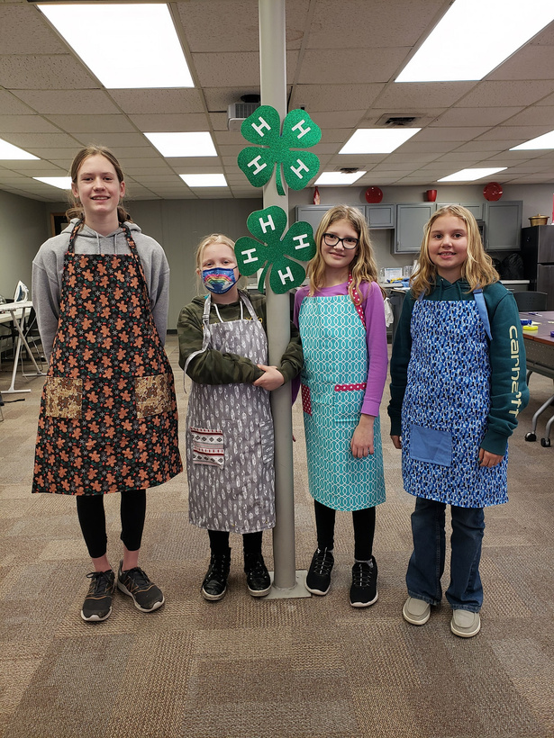
Impacts
Discover Sewing
Relationships
Friendships
Youth/Adult
Social Competence - positive conversations
Belonging

Slide 21
Table Topics
How can or is self-pacing part of your learning experiences?
Are you already doing some version of this?
Needs/Challenges
Ideas

Slide 22
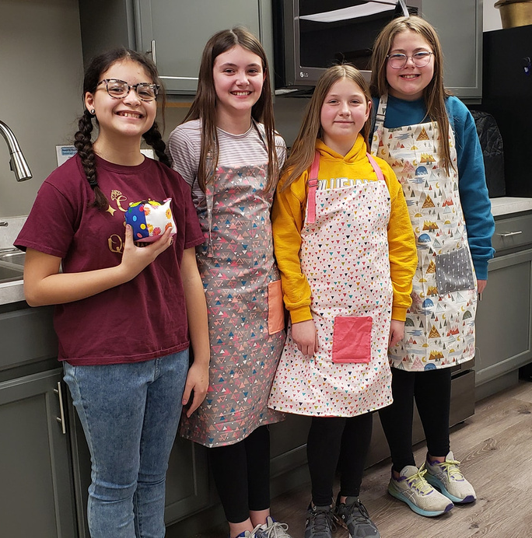
Future Directions
Discover Sewing Club
Eight projects being offered
Increased self-direction - choose projects
from among the eight offered
bring one of their own

Slide 23
Other Options
Self-Paced Learning
STEM - Take A Part Club
STEM - Circuitry
Knitting/Crocheting (or other arts and crafts)
Entrepreneurship/Marketing

Slide 24
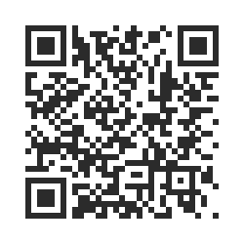
Wrap Up
Evaluation

Slide 25
Thank you!
Please feel free to step up to the sewing machine and Discover Sewing.
17

Slide 26
Sources
https://www.cultofpedagogy.com/
https://www.iste.org/explore/In-the-classroom/5-surprising-results-of-a-self-paced-classroom
https://youth.gov/youth-topics/impact-family-engagement

